Slide 1
Relational Model and Relational Algebra

Slide 2
Relational Model Concepts
The relational Model of Data is based on the concept of a Relation
A Relation is a mathematical concept based on the ideas of sets
The strength of the relational approach to data management comes from the formal foundation provided by the theory of relations.

Slide 3
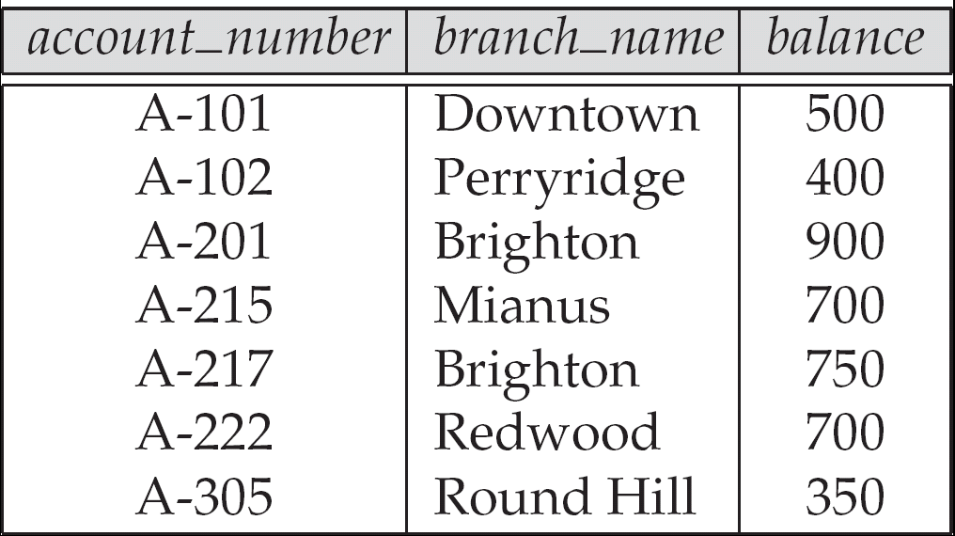
Example of a Relation

Slide 4
Relational Data Structure
Relation
Attribute
Domain
Tuple (extension)
Degree (no. of attributes)
Cardinality (no. of rows)
Relational Database: A collection of normalized relations with distinct relation names

Slide 5
Attribute Types
Each attribute of a relation has a name
The set of allowed values for each attribute is called the domain of the attribute
Attribute values are (normally) required to be atomic; that is, indivisible
E.g. the value of an attribute can be an account number, but cannot be a set of account numbers
Domain is said to be atomic if all its members are atomic
The special value null is a member of every domain

Slide 6
Relation Schemas
Formally, given domains D₁, D₂, …. D_{n} a relation r is a subset of D₁ x D₂ x … x D_{n} Thus, a relation is a set of n-tuples (a₁, a₂, …, a_{n}) where each a_{i} ∈ D_{i}
Schema of a relation consists of
attribute definitions
name
type/domain
integrity constraints

Slide 7
Relation Instance
The current values (relation instance) of a relation are specified by a table
An element t of r is a tuple, represented by a row in a table
Order of tuples is irrelevant
attributes
(or columns)
customer_name
customer_street
customer_city
Jones
Smith
Curry
Lindsay
Main
North
North
Park
Harrison
Rye
Rye
Pittsfield
tuples
(or rows)
customer

Slide 8
Database
A database consists of multiple relations
Information about an enterprise is broken up into parts, with each relation storing one part of the information
E.g.
account : information about accounts
depositor : which customer owns which account
customer : information about customers

Slide 9
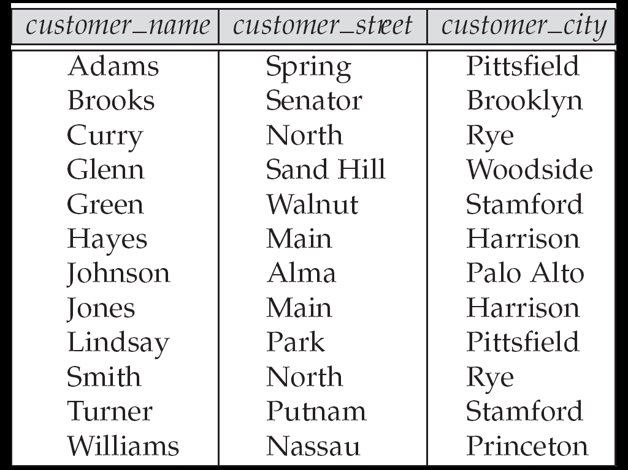
The customer Relation

Slide 10
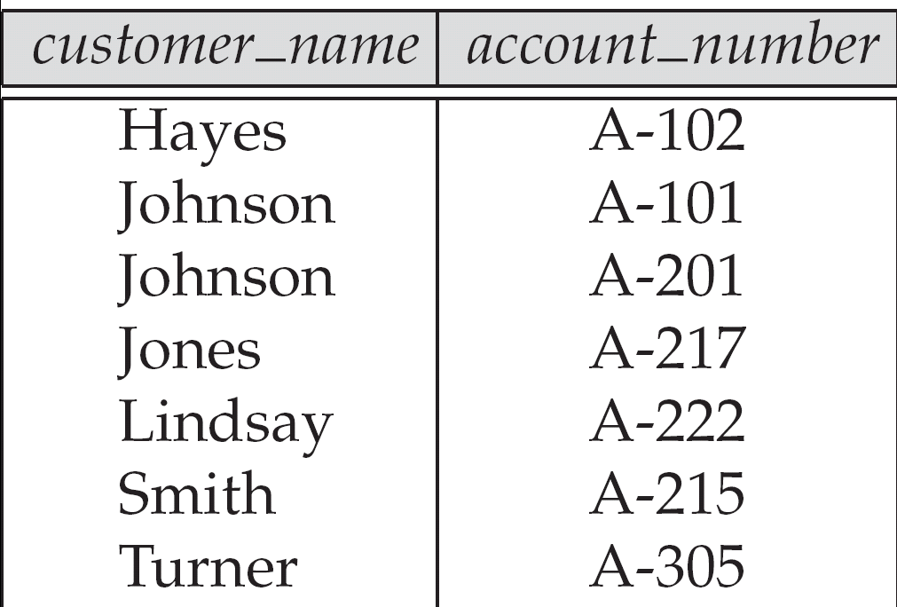
The depositor Relation

Slide 11
Properties of Relation
Relation name is distinct
Each cell of the relation contains exactly one atomic (single) value
Each attribute has a distinct name
The values of an attribute are all from the same domain
Each tuple is distinct (no duplicate tuples)
The order of attributes has no significance
The order of tuple has no significance, theoretically

Slide 12
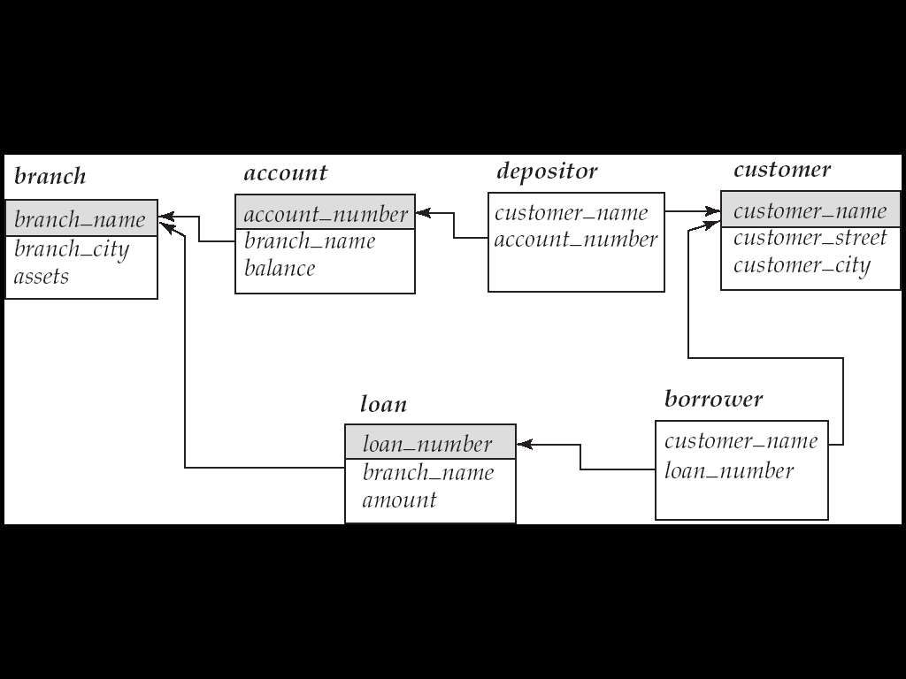
Schema Diagram

Slide 13
Relational Algebra
Procedural language
Six basic operators
select: σ
project: ∏
union: ∪
set difference: –
Cartesian product: x
rename: ρ
The operators take one or two relations as inputs and produce a new relation as a result

Slide 14
Select Operation – Example
Relation r
A
B
C
D
α
α
β
β
α
β
β
β
1
5
12
23
7
7
3
10
σ_{A=B ^ D > 5} (r)
A
B
C
D
α
β
α
β
1
23
7
10

Slide 15
Project Operation – Example
A
B
C
Relation r:
α
α
β
β
10
20
30
40
1
1
1
2
A
C
A
C
∏_{A,C} (r)
α
α
β
β
1
1
1
2
α
β
β
1
1
2
=

Slide 16
Union Operation – Example
Relations r, s:
A
B
A
B
α
α
β
1
2
1
α
β
2
3
s
r
A
B
α
α
β
β
1
2
1
3
r ∪ s:

Slide 17
Set Difference Operation – Example
Relations r, s:
A
B
A
B
α
α
β
1
2
1
α
β
2
3
s
r
r – s:
A
B
α
β
1
1

Slide 18
Cartesian-Product Operation –Example
Relations r, s:
A
B
C
D
E
α
β
1
2
α
β
β
γ
10
10
20
10
a
a
b
b
r
s
r x s:
A
B
C
D
E
α
α
α
α
β
β
β
β
1
1
1
1
2
2
2
2
α
β
β
γ
α
β
β
γ
10
10
20
10
10
10
20
10
a
a
b
b
a
a
b
b

Slide 19
Rename Operation
Allows us to name, and therefore to refer to, the results of relational-algebra expressions.
Allows us to refer to a relation by more than one name.
Example:
ρ _{x} (E) returns the expression E under the name X
If a relational-algebra expression E has arity n, then returns the result of expression E under the name X, and with the attributes renamed to A₁ , A₂ , …., A_{n} .

Slide 20
Composition of Operations
Can build expressions using multiple operations
Example: σ_{A=C}(r x s)
r x s
σ_{A=C}(r x s)
A
B
C
D
E
α
α
α
α
β
β
β
β
1
1
1
1
2
2
2
2
α
β
β
γ α
β
β
γ
10
10
20
10
10
10
20
10
a
a
b
b
a
a
b
b
A
B
C
D
E
α
β
β
1
2
2
α
β
β
10
10
20
a
a
b

Slide 21
Banking Example
branch (branch_name, branch_city, assets)
customer (customer_name, customer_street, customer_city)
account (account_number, branch_name, balance)
loan (loan_number, branch_name, amount)
depositor (customer_name, account_number)
borrower (customer_name, loan_number)

Slide 22
Example Queries
Find all loans of over $1200
σ_{amount > 1200} (loan)
Find the loan number for each loan of an amount greater than $1200
∏_{loan_number} (σ_{amount} _{> 1200} (loan))
Find the names of all customers who have a loan, an account, or both, from the bank
∏_{customer_name} (borrower) ∪ ∏_{customer_name} (depositor)

Slide 23
Example Queries
Find the names of all customers who have a loan at the Perryridge branch.
∏_{customer_name} (σ_{branch_name=“Perryridge”}
(σborrower.loan_number = loan.loan_number(borrower x loan)))
Find the names of all customers who have a loan at the Perryridge branch but do not have an account at any branch of the bank.
∏_{customer_name} (σ_{branch_name = “Perryridge”}
(σborrower.loan_number = loan.loan_number(borrower x loan))) – ∏_{customer_name}(depositor)

Slide 24
Example Queries
Find the names of all customers who have a loan at the Perryridge branch.
∏_{customer_name} (σ_{branch_name = “Perryridge”} ( σborrower.loan_number = loan.loan_number (borrower x loan)))
∏_{customer_name}(σloan.loan_number = borrower.loan_number ( (σ_{branch_name = “Perryridge”} (loan)) x borrower))

Slide 25
Additional Operations
Additional Operations
Set intersection
Natural join
Aggregation
Outer Join
Division
All above, other than aggregation, can be expressed using basic operations we have seen earlier

Slide 26
Set-Intersection Operation – Example
Relation r, s:
r ∩ s:
A B
A B
α
α
β
1
2
1
α
β
2
3
r
s
A B
α 2

Slide 27
Natural-Join Operation
Notation: r s
Let r and s be relations on schemas R and S respectively. Then, r s is a relation on schema R ∪ S obtained as follows:
Consider each pair of tuples t_{r} from r and t_{s} from s.
If t_{r} and t_{s} have the same value on each of the attributes in R ∩ S, add a tuple t to the result, where
t has the same value as t_{r} on r
t has the same value as t_{s} on s
Example:
R = (A, B, C, D)
S = (E, B, D)
Result schema = (A, B, C, D, E)
r s is defined as: ∏_{r.A, r.B, r.C, r.D, s.E} (σ_{r.B = s.B} ∧ _{r.D = s.D} (r x s))

Slide 28
Natural Join Operation – Example
Relations r, s:
A
B
C
D
B
D
E
α
β
γ
α
δ
1
2
4
1
2
α
γ
β
γ
β
a
a
b
a
b
1
3
1
2
3
a
a
a
b
b
α
β
γ
δ
∈
r
s
r s
A
B
C
D
E
α
α
α
α
δ
1
1
1
1
2
α
α
γ
γ
β
a
a
a
a
b
α
γ
α
γ
δ

Slide 29
Bank Example Queries
Find the largest account balance
Strategy:
Find those balances that are not the largest
Rename account relation as d so that we can compare each account balance with all others
Use set difference to find those account balances that were not found in the earlier step.
The query is:
∏_{balance}(account) - ∏_{account.balance}
(σ_{account.balance < d.balance} (account x ρ_{d} (account)))

Slide 30
Aggregate Functions and Operations
Aggregation function takes a collection of values and returns a single value as a result.
avg: average value min: minimum value max: maximum value sum: sum of values count: number of values
Aggregate operation in relational algebra
E is any relational-algebra expression
G₁, G₂ …, G_{n} is a list of attributes on which to group (can be empty)
Each F_{i} is an aggregate function
Each A_{i} is an attribute name

Slide 31
Aggregate Operation – Example
Relation r:
A
B
C
α
α
β
β
α
β
β
β
7
7
3
10
g _{sum(c)} (r)
sum(c )
27

Slide 32
Aggregate Operation – Example
Relation account grouped by branch-name:
branch_name
account_number
balance
Perryridge
Perryridge
Brighton
Brighton
Redwood
A-102
A-201
A-217
A-215
A-222
400
900
750
750
700
_{branch_name} g _{sum(balance)} (account)
branch_name
sum(balance)
Perryridge
Brighton
Redwood
1300
1500
700

Slide 33
Aggregate Functions (Cont.)
Result of aggregation does not have a name
Can use rename operation to give it a name
For convenience, we permit renaming as part of aggregate operation
_{branch_name} g _{sum(balance) as sum_balance} (account)

Slide 34
Outer Join
An extension of the join operation that avoids loss of information.
Computes the join and then adds tuples form one relation that does not match tuples in the other relation to the result of the join.
Uses null values:
null signifies that the value is unknown or does not exist
All comparisons involving null are (roughly speaking) false by definition.
We shall study precise meaning of comparisons with nulls later

Slide 35
Outer Join – Example
Relation loan
loan_number
branch_name
amount
L-170
L-230
L-260
Downtown
Redwood
Perryridge
3000
4000
1700
Relation borrower
customer_name
loan_number
Jones
Smith
Hayes
L-170
L-230
L-155

Slide 36
Outer Join – Example
Join loan borrower
loan_number
branch_name
amount
customer_name
L-170
L-230
Downtown
Redwood
3000
4000
Jones
Smith
Left Outer Join
loan borrower
loan_number
branch_name
amount
customer_name
L-170
L-230
L-260
Downtown
Redwood
Perryridge
3000
4000
1700
Jones
Smith
null

Slide 37
Outer Join – Example
Right Outer Join
loan borrower
loan_number
branch_name
amount
customer_name
L-170
L-230
L-155
Downtown
Redwood
null
3000
4000
null
Jones
Smith
Hayes
Full Outer Join
loan borrower
loan_number
branch_name
amount
customer_name
L-170
L-230
L-260
L-155
Downtown
Redwood
Perryridge
null
3000
4000
1700
null
Jones
Smith
null
Hayes

Slide 38
Division Operation
Notation:
Suited to queries that include the phrase “for all”.
Let r and s be relations on schemas R and S respectively where
R = (A₁, …, A_{m} , B₁, …, B_{n} )
S = (B₁, …, B_{n})
The result of r ÷ s is a relation on schema
R – S = (A₁, …, A_{m})
r ÷ s = { t | t ∈ ∏ _{R-S} (r) ∧ ∀ u ∈ s ( tu ∈ r ) }
Where tu means the concatenation of tuples t and u to produce a single tuple
r ÷ s

Slide 39
Division Operation – Example
Relations r, s:
A
B
B
α
α
α
β
γ
δ
δ
δ
∈
∈
β
1
2
3
1
1
1
3
4
6
1
2
1
2
s
r ÷ s:
A
r
α
β

Slide 40
Another Division Example
Relations r, s:
A
B
C
D
E
D
E
α
α
α
β
β
γ
γ
γ
a
a
a
a
a
a
a
a
α
γ
γ
γ
γ
γ
γ
β
a
a
b
a
b
a
b
b
1
1
1
1
3
1
1
1
a
b
1
1
s
r
r ÷ s:
A
B
C
α
γ
a
a
γ
γ

Slide 41
Examples of Division A/B
B1
B2
B3
A
A/B1
A/B2
A/B3
Notes:
14

Slide 42
Bank Example Queries
Find all customers who have an account at all branches located in Brooklyn city.
∏_{customer_name, branch_name} (depositor account) ÷ ∏_{branch_name} (σ_{branch_city = “Brooklyn”} (branch))

Slide 43
Assignment Operation
The assignment operation (←) provides a convenient way to express complex queries.
Write query as a sequential program consisting of
a series of assignments
followed by an expression whose value is displayed as a result of the query.
Assignment must always be made to a temporary relation variable.
Example: Write r ÷ s as
temp1 ← ∏_{R-S} (r ) temp2 ← ∏_{R-S} ((temp1 x s ) – ∏_{R-S,S} (r )) result = temp1 – temp2
The result to the right of the ← is assigned to the relation variable on the left of the ←.
May use variable in subsequent expressions.

Slide 44
Modification of the Database
The content of the database may be modified using the following operations:
Deletion
Insertion
Updating
All these operations are expressed using the assignment operator.

Slide 45
Deletion
A delete request is expressed similarly to a query, except instead of displaying tuples to the user, the selected tuples are removed from the database.
Can delete only whole tuples; cannot delete values on only particular attributes
A deletion is expressed in relational algebra by:
r ← r – E
where r is a relation and E is a relational algebra query.

Slide 46
Deletion Examples
Delete all account records in the Perryridge branch.
account ← account – σ _{branch_name = “Perryridge”} (account )
Delete all loan records with amount in the range of 0 to 50
loan ← loan – σ _{amount ≥ 0 and amount ≤ 50} (loan)
Delete all accounts at branches located in Needham.
r₁ ← σ _{branch_city = “Needham”} (account branch )
r₂ ← ∏ _{account_number,} _{branch_name, balance} (r₁)
r₃ ← ∏ _{customer_name, account_number} (r₂ depositor)
account ← account – r₂
depositor ← depositor – r₃

Slide 47
Insertion
To insert data into a relation, we either:
specify a tuple to be inserted
write a query whose result is a set of tuples to be inserted
In relational algebra, an insertion is expressed by:
r ← r ∪ E
where r is a relation and E is a relational algebra expression.
The insertion of a single tuple is expressed by letting E be a constant relation containing one tuple.

Slide 48
Insertion Examples
Insert information in the database specifying that Smith has $1200 in account A-973 at the Perryridge branch.
account ← account ∪ {(“A-973”, “Perryridge”, 1200)}
depositor ← depositor ∪ {(“Smith”, “A-973”)}
Provide as a gift for all loan customers in the Perryridge branch, a $200 savings account. Let the loan number serve as the account number for the new savings account.
r₁ ← (σ_{branch_name = “Perryridge”} (borrower loan))
account ← account ∪ ∏_{loan_number, branch_name, 200} (r₁)
depositor ← depositor ∪ ∏_{customer_name, loan_number} (r₁)

Slide 49
Updating
A mechanism to change a value in a tuple without charging all values in the tuple
Use the generalized projection operator to do this task
Each F_{i} is either
the I ^{th} attribute of r, if the I ^{th} attribute is not updated, or,
if the attribute is to be updated F_{i} is an expression, involving only constants and the attributes of r, which gives the new value for the attribute

Slide 50
Update Examples
Make interest payments by increasing all balances by 5 percent.
account ← ∏ account_number, branch_name, balance * 1.05 (account)
Pay all accounts with balances over $10,000 6 percent interest and pay all others 5 percent
account ← ∏ account_number, branch_name, balance * 1.06 (σ _{BAL > 10000} (account )) ∪ ∏ account_number, branch_name, balance * 1.05 (σ_{BAL ≤ 10000} (account))

Slide 51
Null Values
It is possible for tuples to have a null value, denoted by null, for some of their attributes
null signifies an unknown value or that a value does not exist.
The result of any arithmetic expression involving null is null.
Aggregate functions simply ignore null values
For duplicate elimination and grouping, null is treated like any other value, and two nulls are assumed to be the same (as in SQL)

Slide 52
Null Values
Comparisons with null values return the special truth value: unknown
If false was used instead of unknown, then not (A < 5) would not be equivalent to A >= 5
Three-valued logic using the truth value unknown:
OR: (unknown or true) = true, (unknown or false) = unknown (unknown or unknown) = unknown
AND: (true and unknown) = unknown, (false and unknown) = false, (unknown and unknown) = unknown
NOT: (not unknown) = unknown
In SQL “P is unknown” evaluates to true if predicate P evaluates to unknown
Result of select predicate is treated as false if it evaluates to unknown

Slide 53
Bank Example Queries
Find the names of all customers who have a loan and an account at bank.
∏_{customer_name} (borrower) ∩ ∏_{customer_name} (depositor)
Find the name of all customers who have a loan at the bank and the loan amount
∏customer_name, loan_number, amount (borrower loan)

Slide 54
Bank Example Queries
Find all customers who have an account from at least the “Downtown” and the Uptown” branches.
Query 1
∏_{customer_name} (σ_{branch_name = “Downtown”} (depositor account )) ∩
∏_{customer_name} (σ_{branch_name = “Uptown”} (depositor account))
Query 2
∏_{customer_name, branch_name} (depositor account) ÷ ρ_{temp(branch_name)} ({(“Downtown” ), (“Uptown” )})
Note that Query 2 uses a constant relation.

